Slide 1
Big Mountain Resort Analysis
Guided Capstone Project
Mohammed Abdin, 01/20/2022

Slide 2
Context:
Big Mountain has recently installed an additional chair lift. This addition will increases operating costs by $1,540,000 this season.
~350,000 people ski or snowboard visit yearly and buy on average 5 daily passes.
It is assumed that current ticket prices are not capitalizing as much as the market would allow.
Objectives:
What are the most important facilities Big Mountain is providing?
How much could Big Mountain charge based on competitors prices?
What options exist to reduce costs?

Slide 3
Recommendations and Key Findings:
The modeled price that Big Mountain could reasonably charge (based on competitors data) is: $95.87 +/- $10.39
Ticket prices could be raised by at least ~$5 to ~$86 and potentially by ~$25
The 4 most important facilities that Big Mountain provides are:
No of Fast Quads
No. Runs
Acreage of artificial snow
Maximum vertical drop
Proposed Scenarios to improve facilities and save costs are:
Close at least 1 run, closing a single run will not require to lower the ticket price
Add 1 chair and 150ft vertical drop (scenario 2), this would justify increasing ticket price by ~$2
Potentially drop 5 runs (scenario 1.3), this would justify dropping ticket price by ~$1.2
or 8 runs (scenario 1.4), this would justify dropping ticket price by ~$2.2

Slide 4
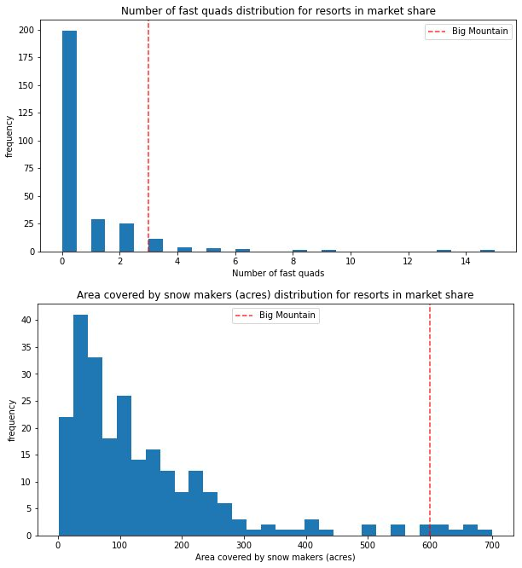
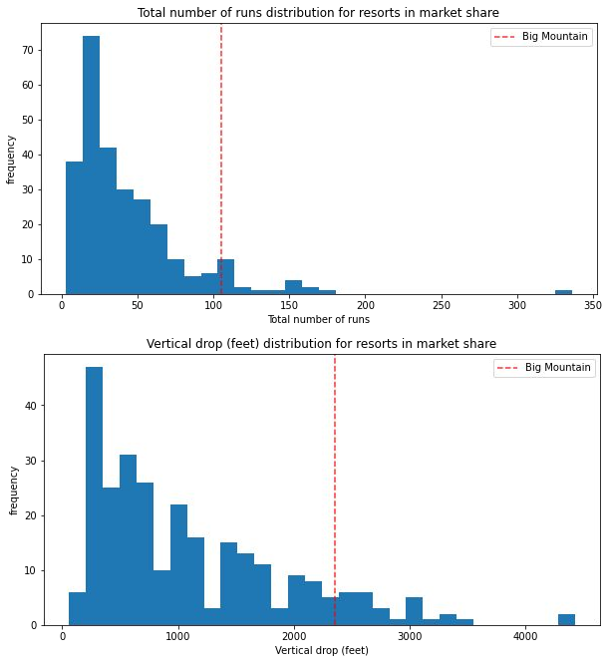
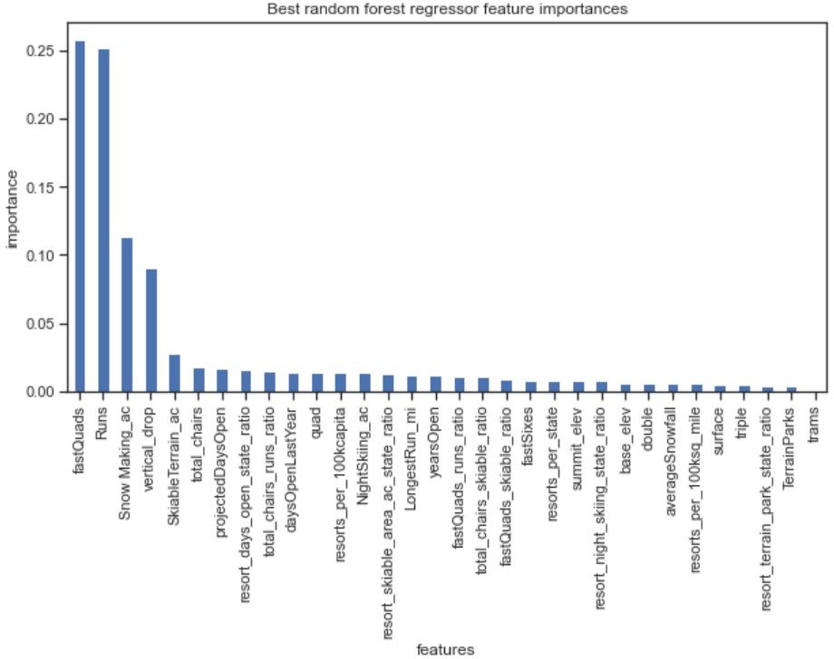
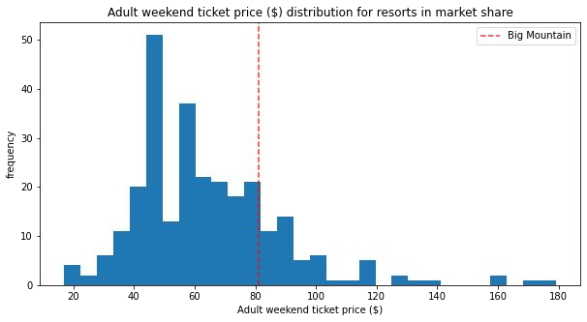
Modeling Results: facilities and price:
Relative importance of facilities offered
Big Mountain Resort
Big Mountain Resort
Big Mountain Resort
Big Mountain Resort
current ticket price
$81.00
modeled ticket price
$95.87
Most Important factors

Slide 5
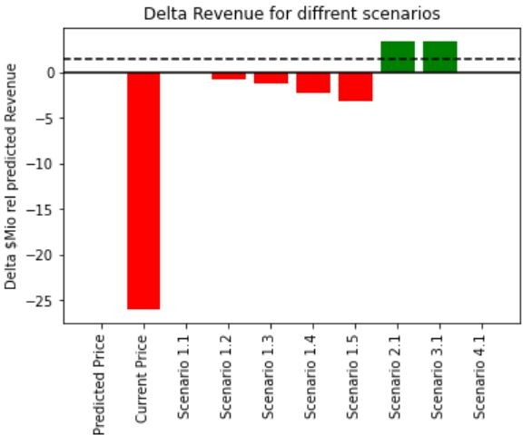
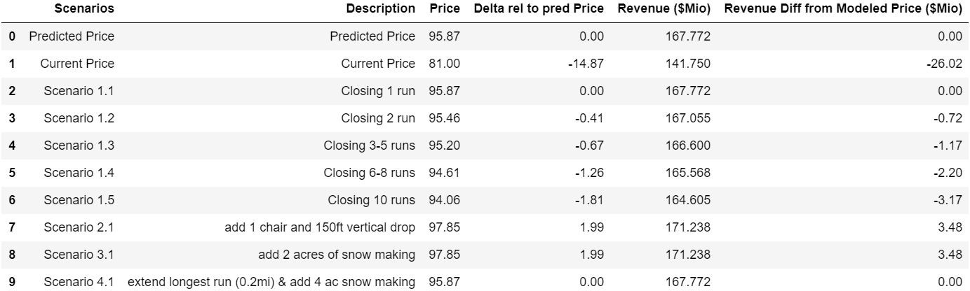
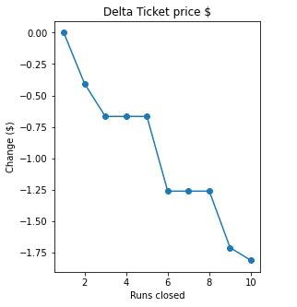
Modeling Results Scenarios:
In total 8 scenarios were modeled:
Dropping 1 run has no impact on ticket price
Dropping 2 or 3 runs leads to a successively lower modeled price
Dropping 5 runs has the same result than dropping 5
Dropping 6 runs has the same result than dropping 8
Dropping 9 or 10 runs successively reduces modeled prices further
Adding 2 acres of snowmaking does not support an increase in ticket prices
Adding 1 chair and 150 ft of vertical drop will support a raise in ticket prices

Slide 6
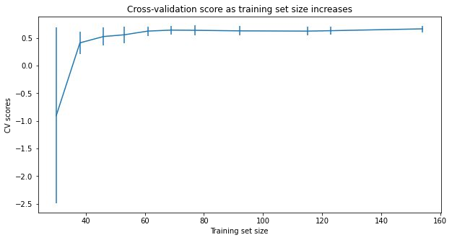
Random Forest Model:
For the Random Forest model using the median value to impute missing values and not scaling the data yielded the best model.
Imputing missing price data with the median vs the average value results in a better model score.
Scaling the data does not improve the model score
The mean absolute cross-validation error (MAE) of the linear model is $9.64 with a standard deviation of
$1.35.
The MAE for the models prediction is $9.54.
The plot above shows that the data available is more than enough to fully characteriize the model. There's an initial rapid improvement in model scores. It levels off by around a sample size of ~50.
The most important features are in descending order of their relative importance:
No. of Fast Quads 0.26
No. Runs 0.25
Acreage of artificial snow 0.11
Maximum vertical drop 0.09

Slide 7
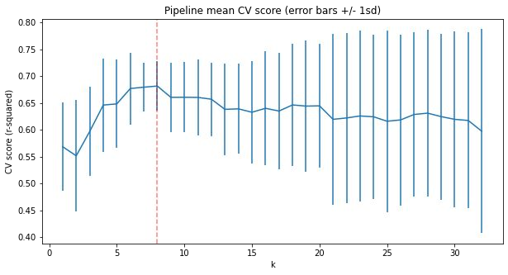
Linear Model:
8 parameters(features) yielded the most stable (cross-verification) model. Using more parameter will likely overfit the model and reduce cross-validation. It was also established that imputing missing data with the median produced statistically indistinguishable results than using the mean value to replace missing data.
The mean absolute cross-validation error (MAE) of the linear model is $10.5 with a standard deviation of
$1.62.
The MAE for the models prediction is $11.79.
The most important features are in descending order of the correlation coefficients:
8 featurers (parameters)
Maximum Vertical Dropf 10.77
Acreage of artificial snow 6.29
Total No. of chairs 5.79
No. of fast Quads 5.75
No. of Runs 5.37

Slide 8
Conclusions:
A linear as well as a Random Forest model were built. Both of these models yield reasonable and consistent results. The Random Forest model was chosen as the final model because it had a smaller mean absolute error and a smaller cross validation error.
The most important 4 parameters of the Random Forest model are among the most important 5 parameters of the linear model indicating that both models are consistent with each other.
This model only looks at ticket prices and costs for a new additional lift. No maintenance costs of runs, snow making and runs were available.
The model indicates that at least 1 run should be closed but it is difficult to make a clear recommendation with the available data alone. Having a better understanding of maintenance costs for lifts and runs would help to optimize recommendations on how many runs should be closed.
In general the current ticket price is relatively low given the amenities Big Mountain Resort offers. The modeled competitors data suggests that the ticket price can be raised by ~$5-$25.
Simply offsetting the increased operating costs due to the newly installed lift can be achieved by a relatively modest increase of <$1.

